Slide 1
Digital Portfolio
STUDENT NAME: B.HEMAPRIYA
REGISTER NO AND NMID: 5708F393959E3F3964B45E4E1F7EAC73
DEPARTMENT: BACHELOR OF COMPUTER APPLICATION
COLLEGE: SRI AKILANDEWARI WOMEN’S COLLEGE WANDIWASH /THIRUVALLUVAR UNIVERSITY

Slide 2
PROJECT TITLE
STUDENT DIGITAL PORTFOLIO USING FRONT END DEVELOPMENT
d

Slide 3


AGENDA
Problem Statement
Project Overview
End Users
Tools and Technologies
Portfolio design and Layout
Features and Functionality
Results and Screenshots
Conclusion
Github Link
3/21/2024 Annual Review

Slide 4

PROBLEM STATEMENT
In modern web design, providing a smooth and interactive user experience is essential, especially on mobile devices. Many websites lack responsive navigation and engaging animations, leading to poor usability. The challenge is to implement a dynamic navigation menu and visually appealing content transitions that enhance user engagement. This project addresses the need for interactive UI by integrating JavaScript-based menu toggling and scroll-triggered animations. The aim is to improve user navigation and content visibility across devices.

Slide 5

PROJECT OVERVIEW
This project focuses on enhancing a website’s user interface using JavaScript. It implements a responsive navigation menu that toggles on mobile view for better accessibility. ScrollReveal.js is used to animate content as the user scrolls, adding interactivity and engagement. The code improves usability by combining functionality with visual appeal. It ensures seamless navigation and content visibility across various screen sizes. Overall, the project upgrades user experience through responsive design and smooth animations.

Slide 6

WHO ARE THE END USERS?
The end users of this project are website visitors who access the site from various devices, especially mobile users. These include customers, clients, or general audiences seeking information or services online. Web developers and designers may also benefit by reusing or learning from the interactive features. Users expect fast, easy-to-navigate, and visually appealing websites. This project aims to meet those expectations by enhancing user experience through responsive design and animations.

Slide 7

TOOLS AND TECHNIQUES
HTML, CSS, JavaScript – Core technologies used for structure, styling, and interactivity.
ScrollReveal.js – A JavaScript library used to animate elements on scroll.
Responsive Web Design – Ensures the layout adapts to different screen sizes.
Event Handling in JavaScript – Used for toggling the navigation menu.
DOM Manipulation – Enables dynamic updates to elements like icons and menus.

Slide 8
PORTFOLIO DESIGN AND LAYOUT
The portfolio layout is clean, responsive, and user-friendly. It includes a header, about section, services, and a project portfolio grid. The navigation menu is designed for both desktop and mobile views with a toggle feature. ScrollReveal animations enhance the user experience by animating content as users scroll. Cards in the portfolio section are arranged in a grid layout with consistent spacing and visual hierarchy. The design focuses on simplicity, readability, and interactivity.
8

Slide 9
FEATURES AND FUNCTIONALITY
Responsive Navigation Menu – Adapts to mobile and desktop views with toggle functionality.
Dynamic Icon Switching – Menu icon changes between open and close states.
Scroll Animations – Elements appear smoothly as the user scrolls, using ScrollReveal.js.
Interactive UI – Buttons and content respond to user interactions.
Section-Based Layout – Clear structure with header, about, services, and portfolio sections.
Clean Visual Design – Focused on readability and user engagement.

Slide 10
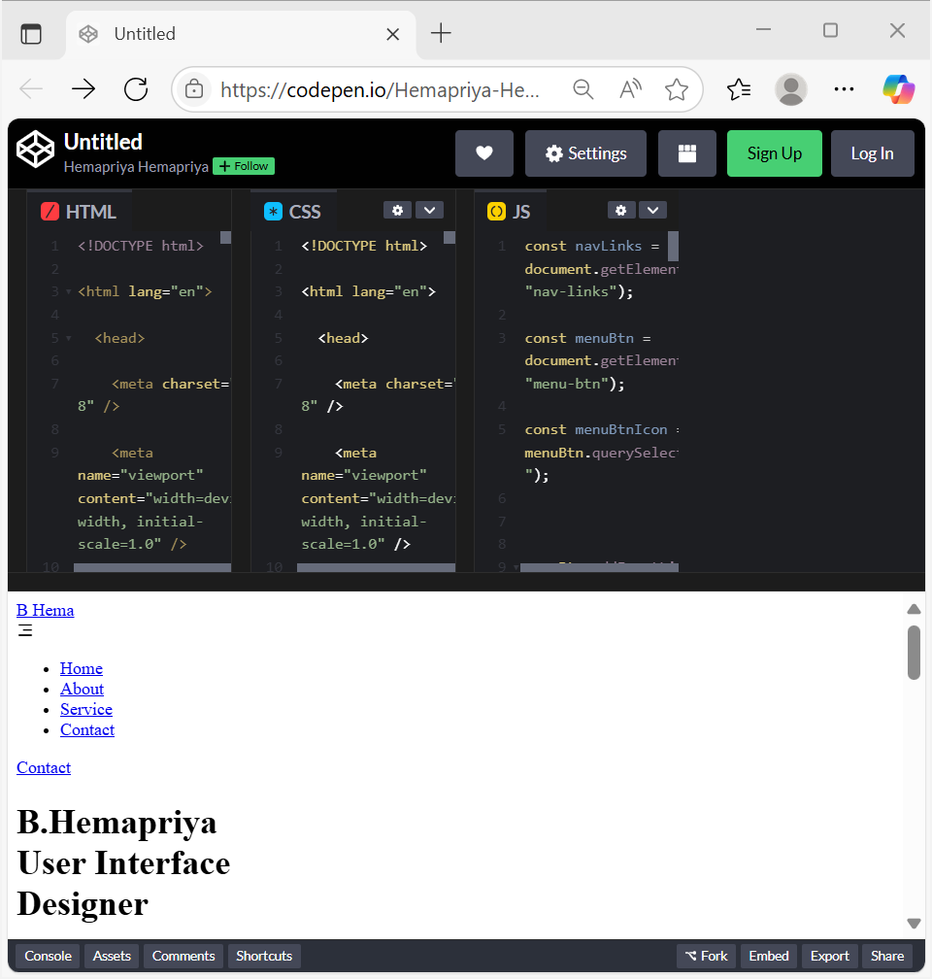

RESULTS AND SCREENSHOTS
https://codepen.io/Hemapriya-Hemapriya/pen/ZYbMmGj
3/21/2024 Annual Review
10

Slide 11
CONCLUSION
This project successfully enhances the user interface with responsive design and smooth scroll animations. It improves navigation and overall user engagement across devices. The implementation demonstrates how simple JavaScript and animation libraries can create a modern, interactive web experience.
11

